Slide 1

JCAPS 5.1 Log4j implementation
Phani Krishna

Slide 2
Pre-requisites
Pre-requisites
  Log4j.jar ( any latest version )

Slide 3
Implementation Steps
JavaCAPS 5.1 does not use the log4j logger as the default logger, while ICAN 5.0 did.
Step 1 : Create a custom log4j.properties with the following lines:
log4j.rootCategory=INFO, FILE
log4j.rootLogger=INFO,FILE
log4j.appender.FILE=org.apache.log4j.RollingFileAppender
log4j.appender.FILE.File=/jcaps/513/QA/lhQA/logicalhost/is/domains/envQA/logs/svcLog.log
log4j.appender.FILE.MaxFileSize=10MB
log4j.appender.FILE.MaxBackupIndex=10
log4j.appender.FILE.layout=org.apache.log4j.PatternLayout
log4j.appender.FILE.layout.ConversionPattern=%d{ISO8601} %-5p [%t] [%c] [%x] %m
NOTE: If we want to have custom logging for another jcd , then insert the same entries with a different file name ( Ex : FILE above gets replaced with FILE1 )

Slide 4

Implementation Steps (cont)
Step 2: Save this custom log4j.properties file to the below directory <caps>/logicalhost/is/domains/<lh>/config
Step 3: Add log4j.jar file to the project.
Step 4: Import log4j.jar ( log4j-1.2.15.jar – any version ) file in the jcd.
Step 5: Add "import org.apache.log4j.*;" to the collaboration code.
Step 6: Add the following declarations to the collaboration's class definition:
static Logger myLogger = Logger.getLogger( "FILE" );

Slide 5
Implementation Steps(cont)
Step 7: Add the following piece of code to the main method.
String prefix = System.getProperty( "user.dir" );
String file = "log4j.properties";
org.apache.log4j.PropertyConfigurator PropertyConfigurator = new org.apache.log4j.PropertyConfigurator();
PropertyConfigurator.configure( prefix +System.getProperty( "file.separator" )+ file );
myLogger.info( "Testing Custom Logging" );

Slide 6
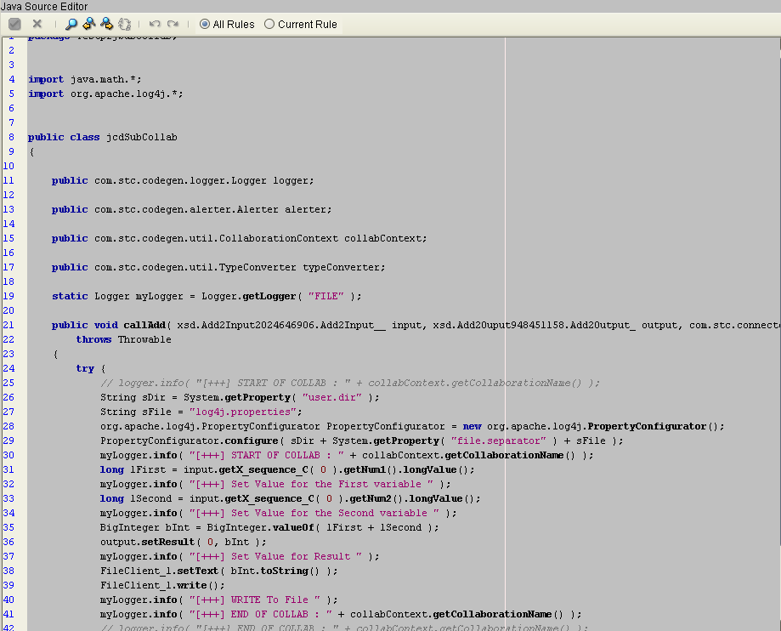
Screenshot

Slide 7
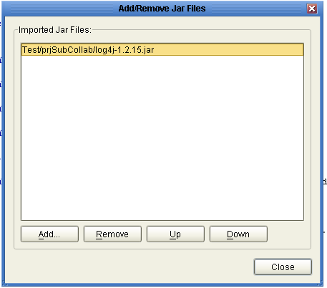
Screenshot (cont)

Slide 8
Thank You
Phani Krishna

